Slide 1
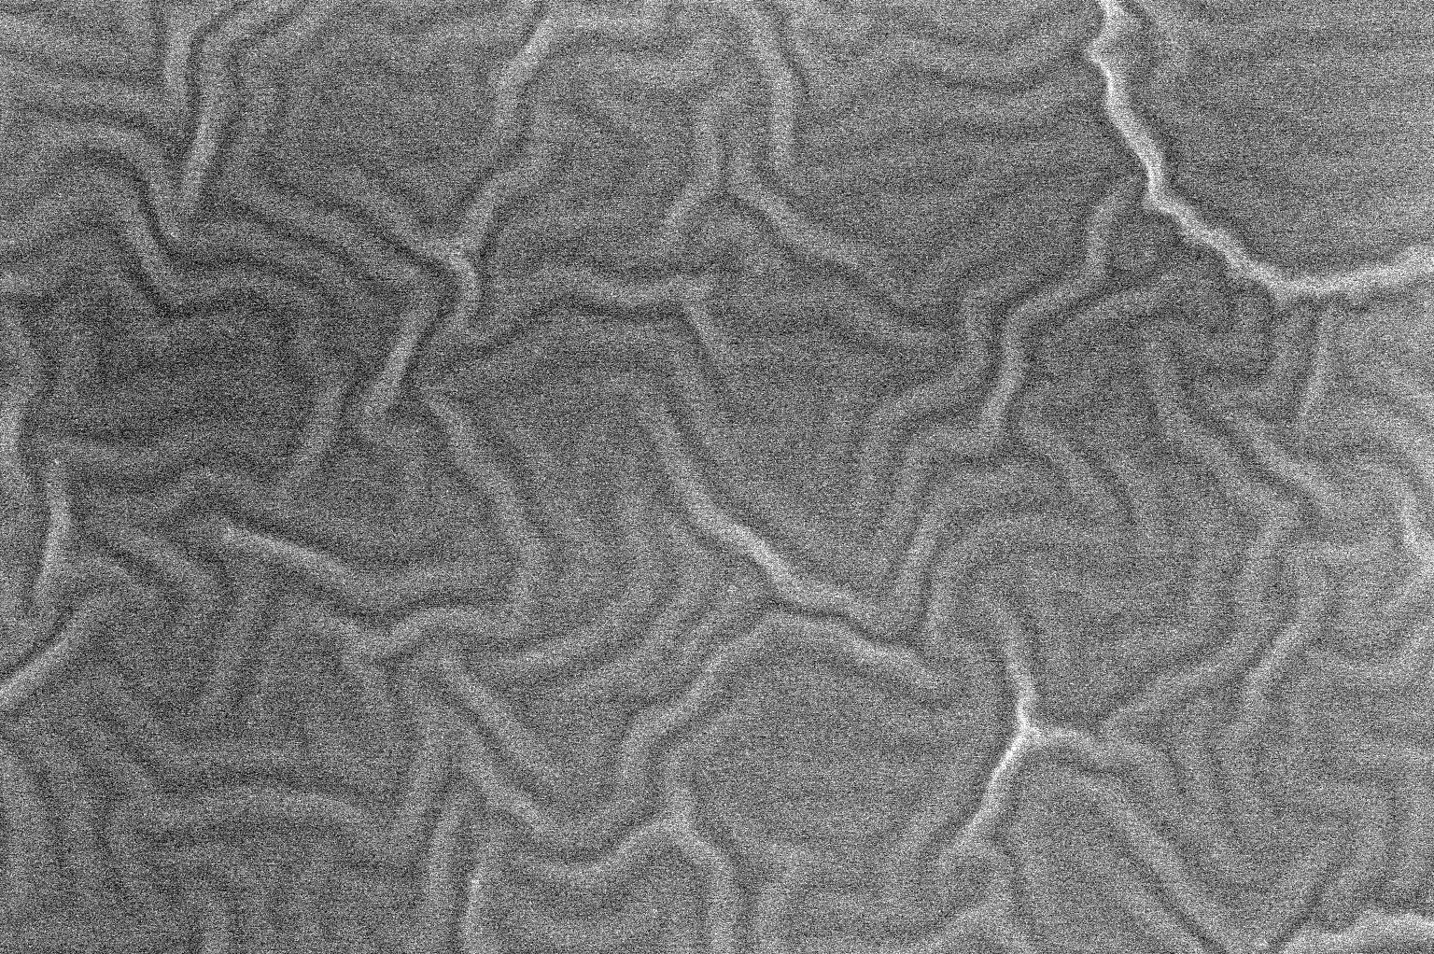


Auto-Regulatory Wrinkled Hydrogel System for Humidity Sensing
Young-Ah (Lucy) Lee
21 May 2019
Notes:
Screen; SLOW; Inflection at ends; TECHNICAL!

Slide 2

Presentation Outline
Auto-Regulatory Wrinkled Hydrogel System for Humidity Sensing
Background
Stimuli-responsive hydrogels
Patterning gels for smart systems
Negative auto-regulation
Motivation
Results
Wrinkled hydrogels
Photothermal nanoparticle arrays
Summary and Future Work

Slide 3
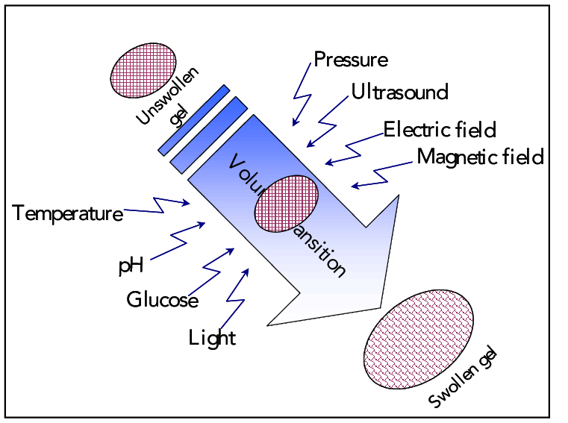
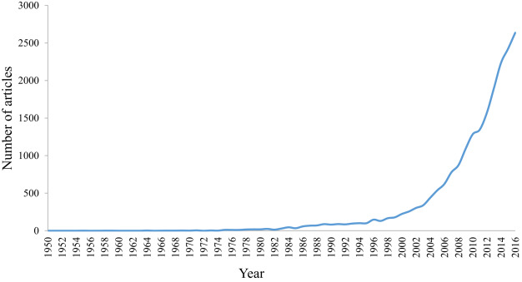
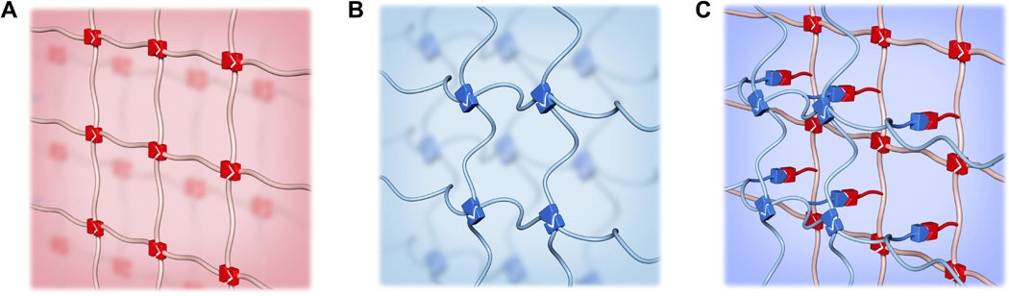
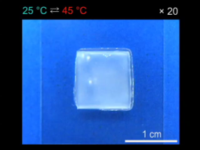
Stimuli-Responsive Hydrogels
3D cross-linked (chemical or physical) network of hydrophilic polymer chains
Insoluble in water
Can swell up to 100-1000x its weight in short time and retain the water
Environment-responsive
Change in volume or stiffness
Reversible
Can form interpenetrating networks
“hydrogels”
N. Kashyap et al., Crit. Rev. Ther. Drug Carrier Syst. 22, 107 (2005)
Applications:
Drug delivery
Tissue, cell engineering
Sensor, actuators, soft robotics
Microfluidics
Contact lenses
M. Mahinroosta et al., Mater. Today Chem. 8, 42 (2018)
L. Xu et al., Sci. Adv. 5, eaau3442 (2019)
Y. S. Kim et al., Nat. Mater. 14, 1002 (2015)
Notes:
Thermoresponsive layered structure titanate nanosheets with PNIPA

Slide 4
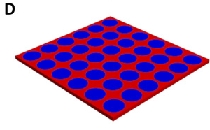
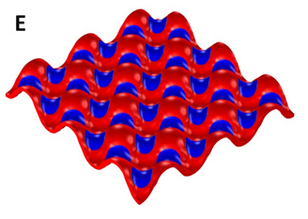
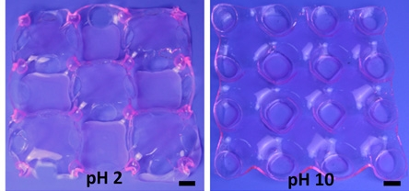
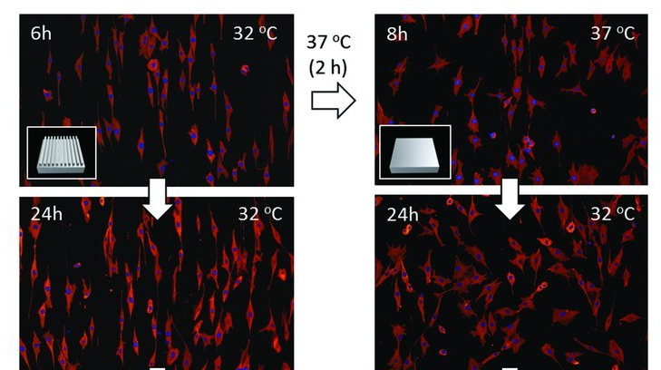
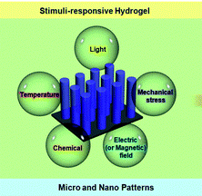
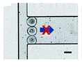
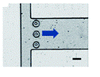
Patterning Stimuli-Responsive Hydrogels
Stimuli-responsive hydrogels can be combined with patterning by micro- and nanofabrication technologies to develop smart, functional systems with
another level of control added by the structuring
Z. J. Wang et al., Sci. Adv. 3, e1700348 (2017)
M. Ebara et al., Adv. Mater. 24, 273 (2012)
D. Beebe et al., Nature 404, 588 (2000)
D H. Kang et al., Analyst 138, 6230 (2013)
Notes:
Programmable complex deformation for actuators and soft robotics/stretchable electronics and controlled wettability
Bending, twisting, folding in cooperative deformation through periodic unswelling discs 1cm; photolitho with mask
300um
Cell proliferation, alignment, migrate and grow, pcl-acrylate, master grooves

Slide 5
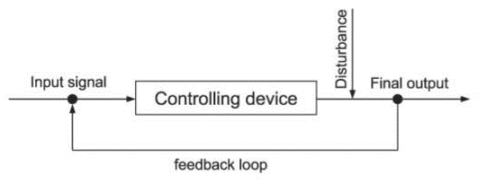
Regulatory Systems with Feedback Loops
A. Mitrophanov and E. Groisman, Bioessays 30, 542 (2008)
Feedback: the property of a control system to use its output as (a part of) its input
Positive feedback: the type of feedback when a deviation in the controlled quantity is further amplified by the control system
Negative feedback: the type of feedback when a deviation in the controlled quantity is counterbalanced by the control system
Engineering stimuli-responsive hydrogel systems
to be auto-regulatory or self-adjusting
Notes:
“sensor” “actuator” communicate adjust the response rate/degree/intensity; not just on/off

Slide 6
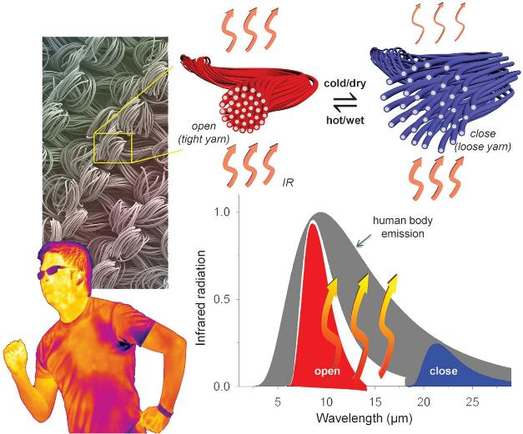
Multi-Material Stimuli-Responsive System
with Auto-Regulation
Responsive to heat and humidity
Self-adjusting
Humidity-responsive mechanical actuation from bimorph polymer
Heating from CNTs
X. A. Zhang et al., Science 363, 619 (2019)
Notes:
polymer fibers coated with carbon nanotubes. The yarn itself expanded and collapsed based on heat and humidity, which changed the spacing of the fibers. Wider fiber spacing allowed the textile to breathe but also altered the infrared emissivity of the textile.
A cloth that adapts to the heat
Textiles trap infrared radiation, which helps keep us warm in cold weather. Of course, in hot weather, this is less desirable. Zhang et al. constructed an infrared-adaptive textile composed of polymer fibers coated with carbon nanotubes. The yarn itself expanded and collapsed based on heat and humidity, which changed the spacing of the fibers. Wider fiber spacing allowed the textile to breathe but also altered the infrared emissivity of the textile. This allowed for better heat exchange under hot and wet conditions. The self-adjusting emissivity of the textile could help toward wearable thermal-management attire.
Dynamic and self-adaptive IR radiation tuning
Novel designs with CNT-coated bimorph metafibers
Commercially compatible large-scale fabrication
Inspiring multi-material thermal-responsive polymers

Slide 7
Design Principles for System with Negative Auto-Regulation
The innovative factor in our design is that the hydrogel system will be driven by auto-regulation, where negative feedback loop plays a critical role.
Process: a change in the external humidity regulated by the system-induced heating
Two components:
Wrinkle-patterned hydrogel as the sensor for humidity variance
Metal nanoparticle (NP) array as the regulator through plasmonic heating
humidity
heating
Change in humidity
Wrinkles flatten
Less light scattered, more transmitted
←
Heated environment and heat-induced ←
wrinkling and less light transmitted
←
Light-induced heating in plasmonic NP array
Notes:
Periodic metal nanoparticle arrays sustain sharp and intensesurface lattice resonances (SLR) that can strongly enhance optical scattering and absorption. At resonance wavelengths, light is trapped in the nanoparticle array and the energy dissipated by heatSLR wavelength toward that of the light source and hence trigger local heat generation.
Collective responses of localized surface plasmon resonances, known as surface lattice resonances (SLRs) in metal nanoparticle arrays

Slide 8
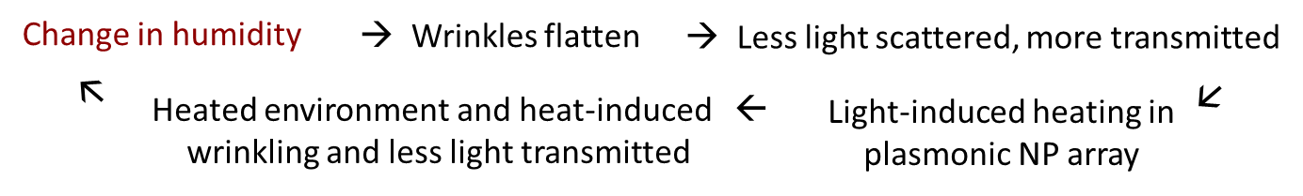
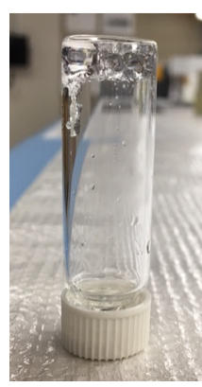
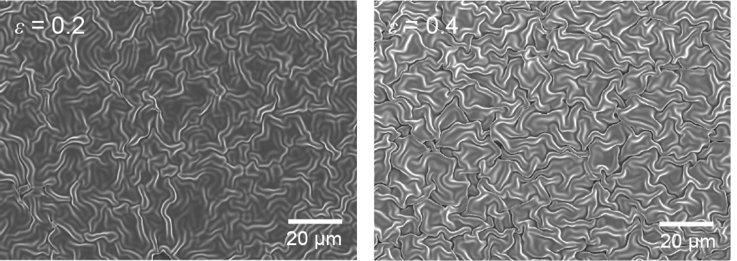
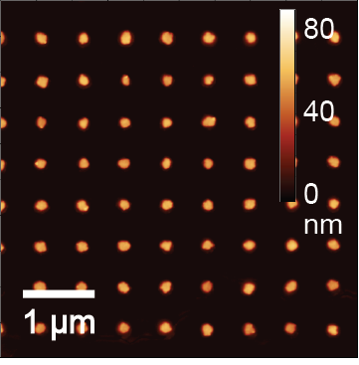
Systematic Study of the Multi-Component System
Hydrogel synthesis (PAAm chemical polymerization)
Optimization for elasticity (cross-linking density, rate of polymerization)
Wrinkle fabrication with skin layer deposition (RIE plasma treatment)
Wrinkle wavelength as function of humidity variance
Optical transmittance as function of wrinkle wavelength
NP array fabrication (SANE/PEEL)
Photothermal activity as function of NP density, dimensions, composition, and amount of incident light
Index matching between NP array substrate and hydrogel
Notes:
FUNDAMENTAL vs. ENGINEERING aspects/questions; careful design of materials, fabrication, mechanism

Slide 9
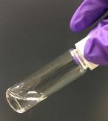
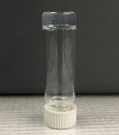
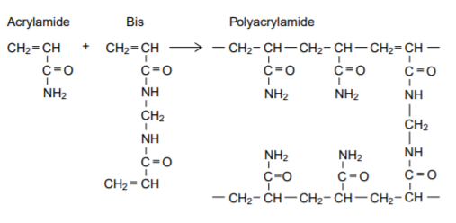
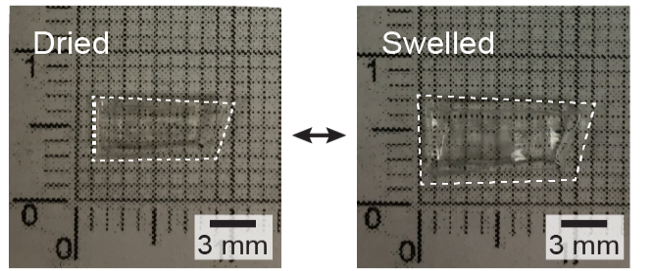
Polyacrylamide (PAAm) Hydrogel Synthesis
Swelling ratio = [(x_{s}-x_{d})/x_{d}] * 100%
Gravimetric (m) or volumetric (V)
5 min hydration – 85% | 60%
Full hydration – 550% | 185%
Polyacrylamide (PAAm) gels are formed by copolymerization of acrylamide and bis-acrylamide. The reaction is a vinyl addition polymerization initiated by a free radical-generating system. Polymerization is initiated by ammonium persulfate (APS) and TEMED.
http://www.bio-rad.com/webroot/web/pdf/lsr/literature/Bulletin_1156.pdf
Chemical polymerization (or can be done photochemically with UV light)
Fast reaction, tunable components, room temperature processing
Modulus dependent on the cross-linking density and the rate of polymerization
Effect of gel modulus on buckling patterns
Optimized Synthesis Protocol
995 μL of 0.25 g/mL acrylamide + 0.013 g/mL bis-acrylamide
*solution must be degassed for > 20 minutes
10 μL of 10 % w/v ammonium persulfate (APS)
1 μL of N,N,N′,N′-Tetramethylethylenediamine (TEMED)
Notes:
Western blot, biocompatible

Slide 10
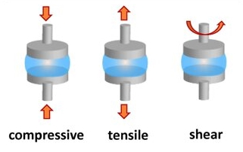
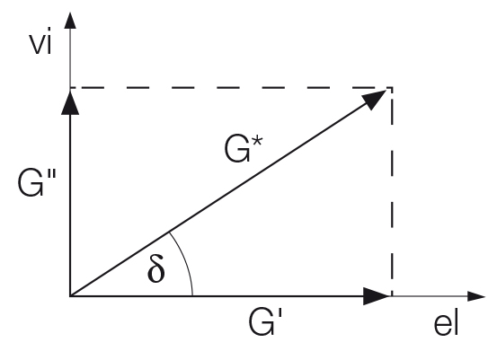
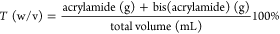
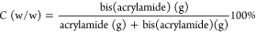
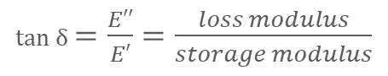
Characterizing PAAm Hydrogel Properties
 | Water Content | Elastic modulus | Index of refraction
DRY | 0 g | 9x10⁵ kPa (tan 0.05) | 1.55
WET | 0.018 g | 90 kPa (tan 0.05) | 1.53
13%T, 5%C
5 min hydration
PDMS – 1650 kPa
PS – 3x10⁶ kPa
Glass – 1.52
tan δ $=\frac{E′′}{E′}=\frac{loss modulus}{storage modulus}$
A. Denisin and B. Pruitt, ACS Appl. Mater. Interfaces 8, 21893 (2016)
https://phys.org/news/2019-02-semi-flexible-model-based-analysis-cell-adhesion.html
https://wiki.anton-paar.com/en/basics-of-rheology/
Notes:
Water n = 1.33

Slide 11
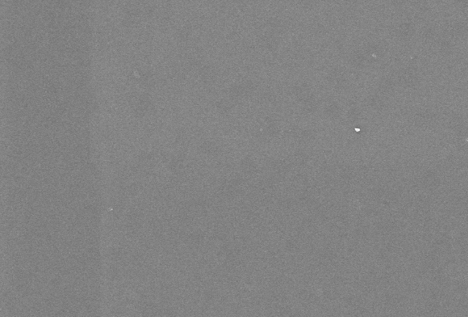
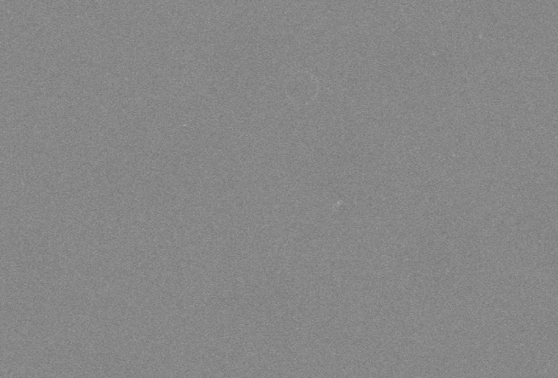
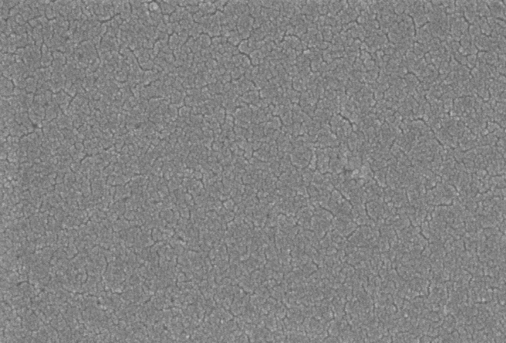
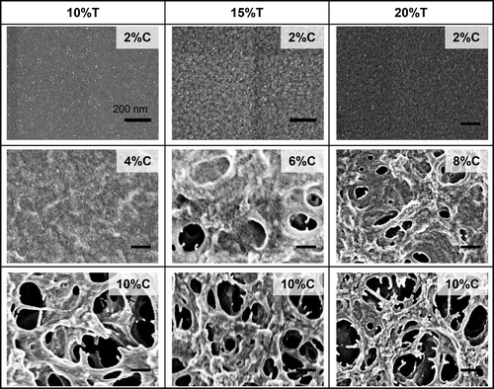
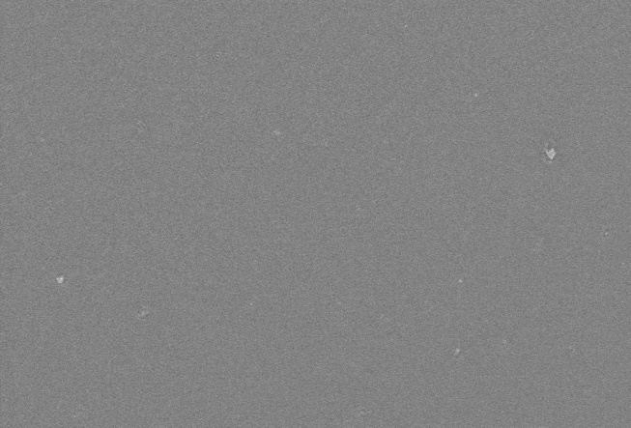
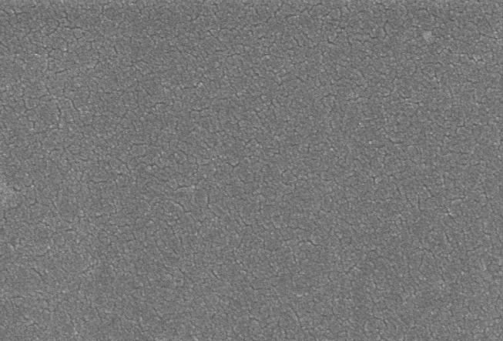
Initial Surface Morphology
of 5%C PAAm Hydrogels
10 µm
2 µm
200 nm
Higher concentrations of initiator and catalyst
10 µm
2 µm
200 nm
A. Denisin and B. Pruitt, ACS Appl. Mater. Interfaces 8, 21893 (2016)
Confirmed to be flat and without any pores
Same morphology with increased concentrations of initiator and catalyst for faster gelation

Slide 12
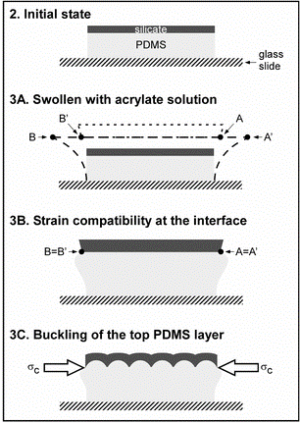
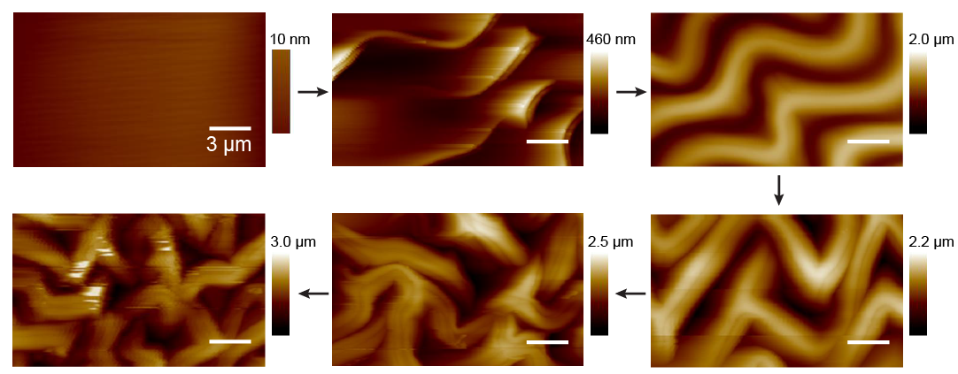
Swelling-Induced Formation of Buckling Patterns
Wet → Dry
PS – thermal
PDMS – mechanical
Hydrogel – swelling
Degree of pre-strain comes from the amount of swelling
5 min hydration → 60% volumetric expansion → ɛ_{pre} = 0.6
Under 5 min hydration – ESEM
5 µm
Wrinkle features form with decreased wavelength and increased amplitude as the substrate is compressed under dehydration
Strain is applied isotropically in all x, y, and z directions
E. P. Chan and A. J. Crosby, Soft Matter 2, 324 (2006)

Slide 13
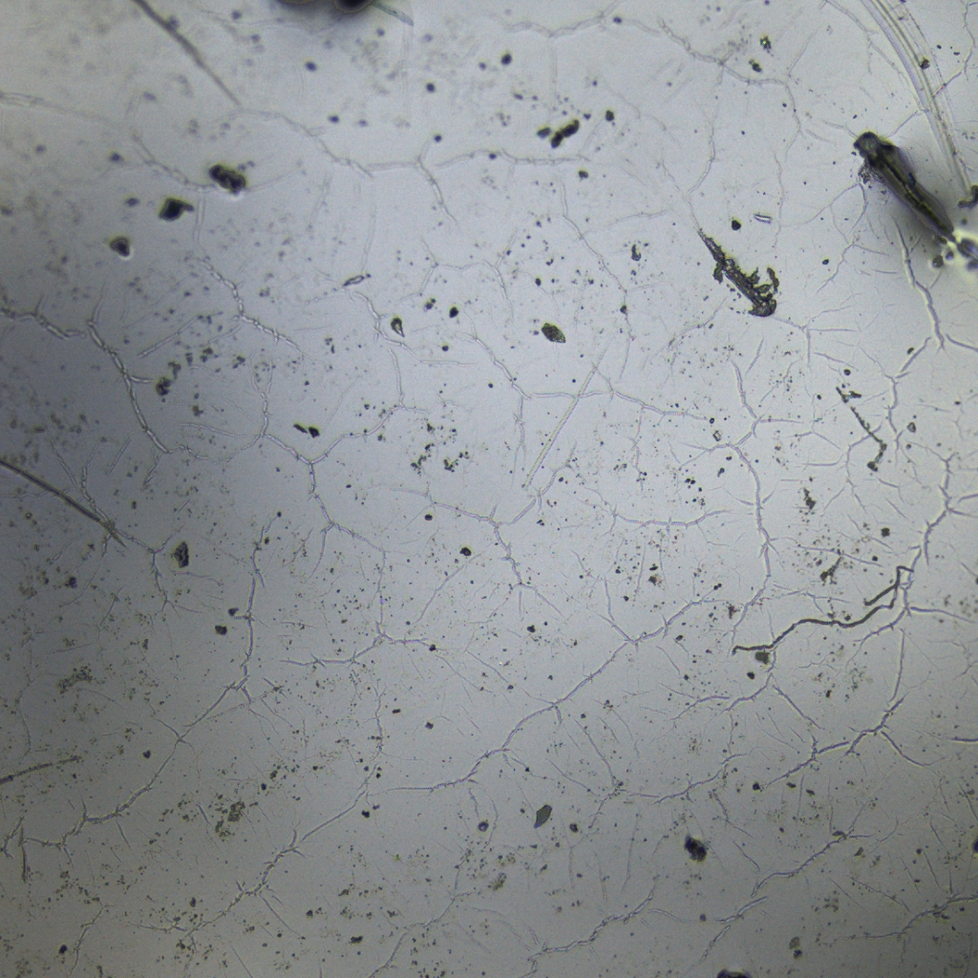
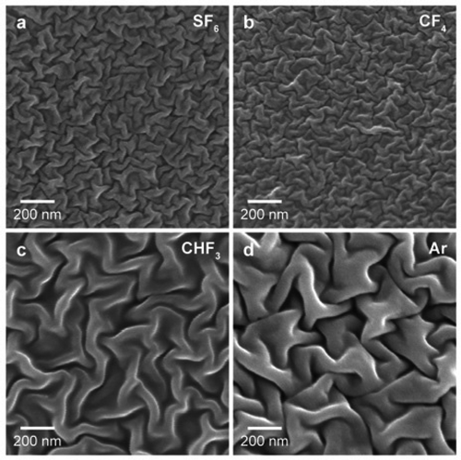
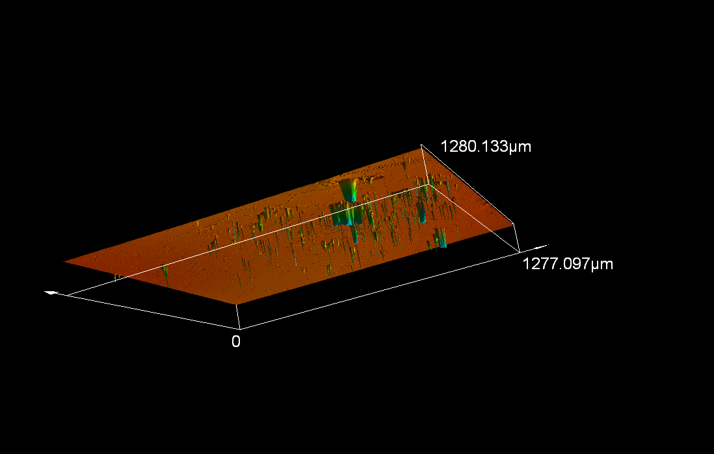
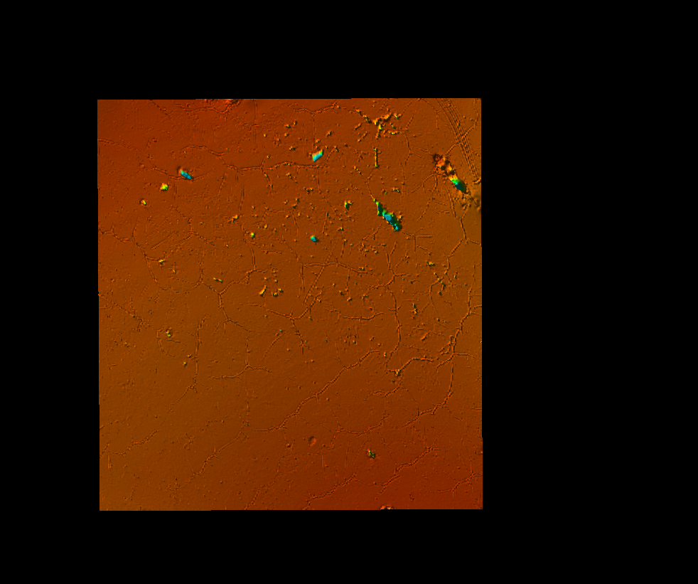
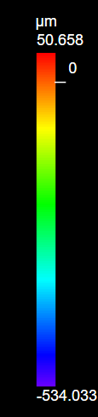
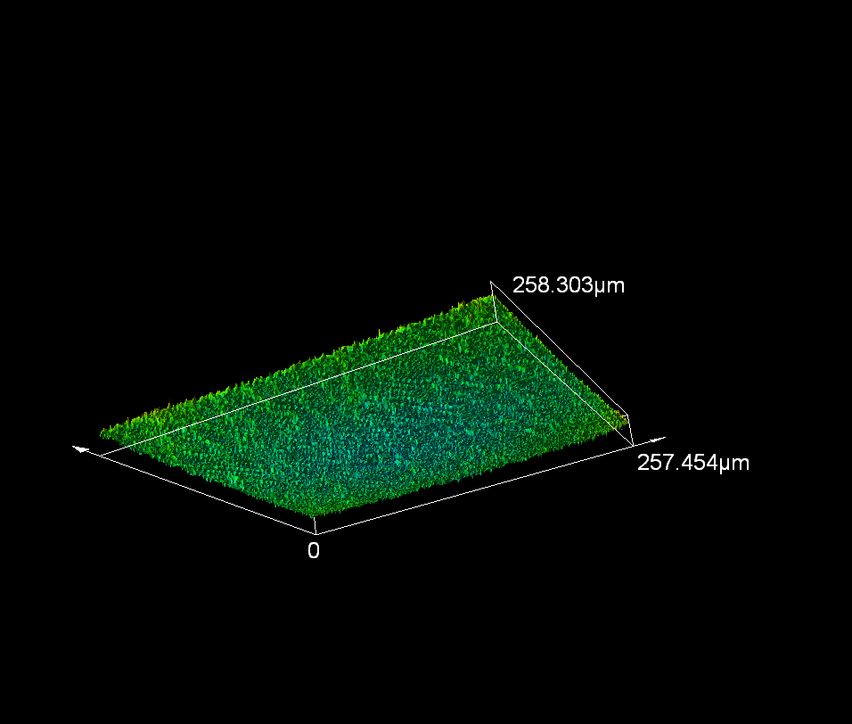
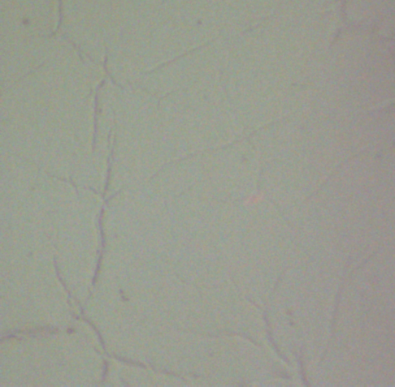
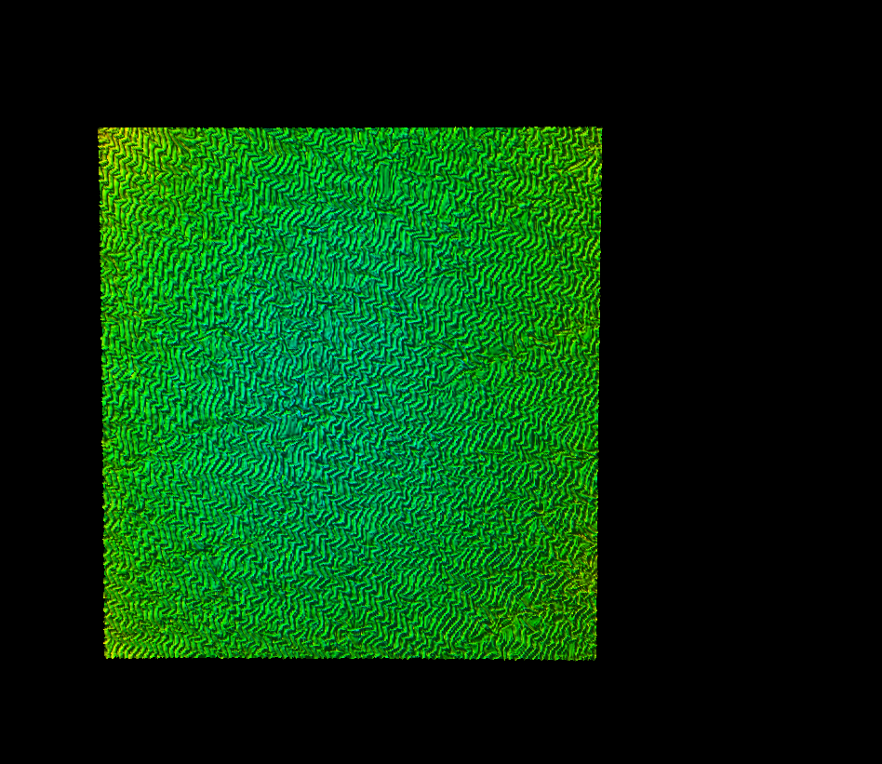
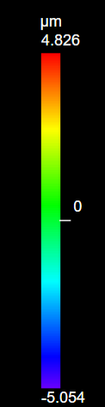
Exploring Oxygen Skin
Oxygen plasma treatment etched the surface rather than creating a skin layer. Some kind of buckling patterns could be seen but not wrinkle features.
SS
Confocal Laser Scanning Microscopy (CLSM)
200 µm
O₂ plasma treated
260
M. Huntington, T. Odom et al., ACS Appl. Mater. Interfaces Matter 5, 6438 (2013)
Wavelengths of the wrinkles prepared with SF₆, CF₄, and Ar plasma treatment are invariant
CHF₃ plasma makes the surface hydrophobic
CHF₃ plasma treated
50 µm
Notes:
Addressing hydrophobicity

Slide 14
Correlating Fluoropolymer Skin Layer Thickness
to RIE Treatment Times
Fluoropolymer skin layer on
PAAm hydrogel substrate
Slope = 0.48
R² = 0.999
Fluoropolymer skin layer formed by CHF₃-plasma reactive ion etching (RIE) treatment
Thickness measured by fitting ellipsometry measurements to the Cauchy model

Slide 15
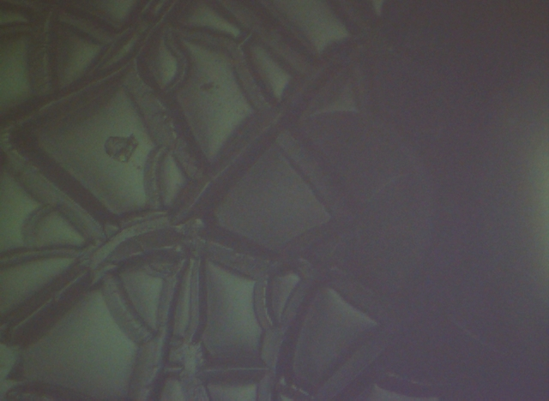
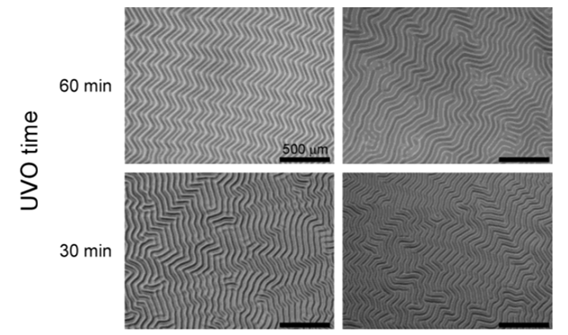
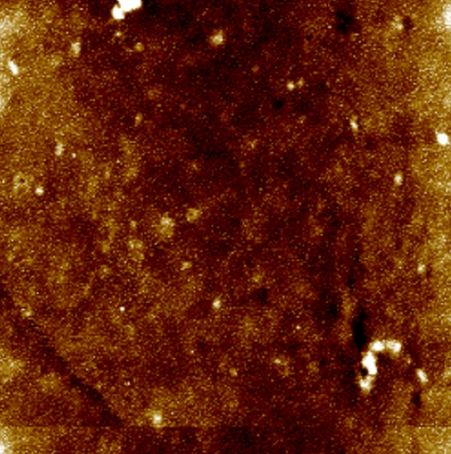
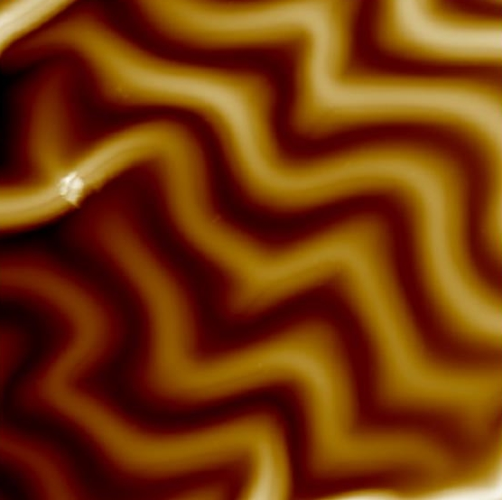
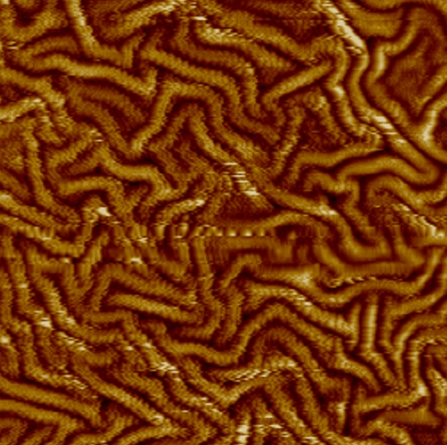
Tunable Patterns by Varying the Skin Layer Thickness
25 nm
h – 290 nm
No wrinkle patterns due to delamination
2 µm
100 µm
D. Breid and A. Crosby, Soft Matter 7, 4490 (2011)
herringbone
labyrinth
2.2 µm
470 nm
h – 50 nm
λ – 5.1 µm
Amp – 790 nm
h – 10 nm
λ – 1.1 µm
Amp – 150 nm
4 µm
4 µm
Notes:
AFM not good way – artifacts
10 min = 291 nm; 2 min = 53 nm; 30 sec = 11 nm

Slide 16
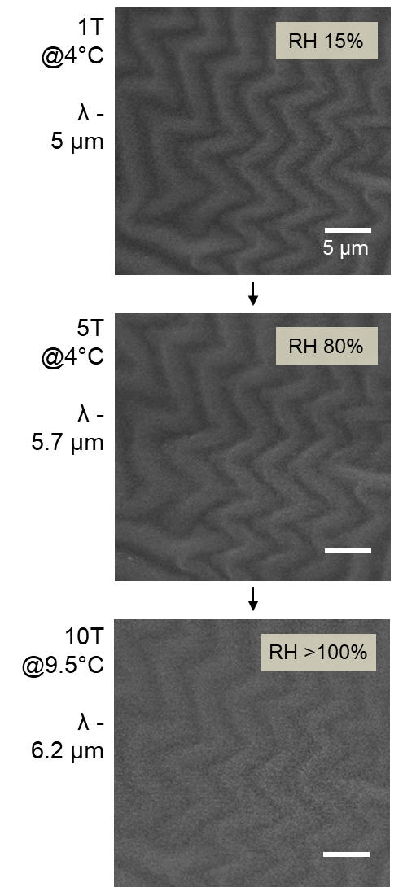



Observing Changes in Wrinkle Topography under Humidity via ESEM
Relative humidity (RH) – dependent on temperature and pressure
At 4°C, saturated water vapor pressure (RH = 100%) is reached at 6.1 Torr and condensation starts above that pressure.
These wrinkles were fabricated with ɛ_{pre} = 0.6 from 5 min hydration
Equivalent (or more) strain should be applied to reach a flat state
swelling by 5 min (or longer) hydration
not possible by the ESEM set-up
Wrinkles can be fabricated with less pre-strain amount by using
Humidity-controlled environmental chamber
Notes:
Other lit: wavelength not really change but width or z ; x y AND z!
4C typical for imaging purpose

Slide 17






Reversible Transitions of the Wrinkle Patterns
under Hydration and Dehydration
dry
wet
8 m
10 µm
26 m
18 m
13 m

Slide 18



Quantifying the Dynamics of Wrinkle Patterns Change via Roughness Factors
Relative estimate of the timescale of wrinkle topography changes in response to heating/drying
Root mean square height (RMS)
Standard deviation of the height distribution
Arithmetical mean height (Ra)
Mean of the average height difference for the average plane
From Roughness measurement guidebook for
laser microscope LEXT OLS5000 by Olympus (2017)
Notes:
can be tuned in accordance to the required responsiveness of the designed system

Slide 19

Modeling/Simulations Overview
Collaboration with Dr. Suzanne Neidhart from Prof. George Schatz’s Group

Slide 20



Calculating the Extent of Heating from NP Arrays
SS
Temperature Change
Confinement
Physical derivation of heating by ensemble of NPs
A. Govorov et al., Nanoscale Res. Lett. 1, 84 (2006)
Mathematical derivation of heating by NP periodic array that matches well with experimental measurements
G. Baffou et al., ACS Nano 7, 6478 (2013)
Notes:
2 factors – added heat fluxes of each NP but also Electric field enhancement to give collective plasmon resonsances; using general physical laws and eqs
Spatial density D; coordinate r
Heat Q comes from light dissipation based on j current density and E of electric field – NPs interaction through E fields to give enechnace and then hot spots with much enhance – heat realized by the system – dissipation of light erg/s
q (of each unit cell) = abs*I
NP considered point like source of heat

Slide 21

FDTD Absorption Spectra
Square lattice
Gold cylindrical NP with
50 nm height
Glass substrate of n = 1.52
Bloch boundary conditions in x, y-direction
PML boundary conditions in z-direction
Finer mesh around NP with size of 1-2 nm
A = (1 – T) – R
W. Zhou and T. Odom, Nat. Nanotechnol. 6, 423 (2011)
Notes:
Extinction (1-T) into scattering(R) and absorp – where we decompose extinction into its scattering and absorption contributions
Lumerical gives T and R
Tunable subradiant (dark mode) lattice plasmons by out-of-plane dipole – by large height tuning (100nm)
Bloch - way the system is set up should account for in plane scattering

Slide 22


Beam Diameter Greatly Influences
Temperature Change in the Lattice
Notes:
Gaussian beam used but use pinhole filter the center of beam, can change the spot size as wanted

Slide 23




Confinement Occurs with Reduced Beam Diameter
When ζ ≫ 1, temperature increase is unaffected by the other particles and temperature distribution is confined around each NP
When ζ ≪ 1, temperature of each NP is mostly due to the overall heating of the N – 1 other neighboring particles and collective effect is dominant
SS
G. Baffou et al., ACS Nano 7, 6478 (2013)
Tighter and bigger, less confined
Trade-off between temperature change
and confinement with beam size
Notes:
TIQSI – thermal imaging using quadriwave shearing interferometry (submicro) empterature induce change in refra

Slide 24

Hydrogel Reduces the Temperature Change
∆T in PAAm
∆T in air
Notes:
Air 0.026; PAM 0.38
DDA discrete dipole approximation with GDT green’s dyadic tensor methods (green’s function formalism) numerical sim with temp profiles
Exp changes in ref index of surrounding medium CCD with Hartmann diffraction grating OM ech; diffraction limited spatial resolution and <K temp variate detected

Slide 25

Heat Transfer in Hydrogel Medium
Mechanisms of Heat Transfer
(electrons, phonons)
Skin thickness
– 50 nm
Gel thickness
Dry – 0.6 mm
Wet – 1.2 mm
Heat would be radiative from the NP array and then conductive from the NP to the hydrogel. Then heat through the polymer could be both by conduction and convection, depending on the role the water molecules play.
https://www.nuclear-power.net/nuclear-engineering/heat-transfer/conduction-convection-radiation/
Electronic heating, then propagation of phonons within the gel medium
Timescale of energy transfer/dissipation from particles to environmental surrounding
Notes:
Convection is usually a slower mechanism for heat transport due to the need for molecules to move.

Slide 26


Thermal Conductivity of PAAm Hydrogel
at the Nanoscale
heat
Temperature distribution at different times
PAAm in isolation with
40 monomers
S. Xu et al., ACS Appl. Mater. Interfaces 10, 36352 (2018)
Polymer chain length (cross-linking)
Water uptake
Salts, ions
Water uptake:
After 5 min of hydration: 0.018g
At full hydration: 0.097g
42: 1 ratio of monomers to cross-linkers
Notes:
Timescale and extent of heating -- Swelling rate,
2-3 angstrom = 0.2/3 nm 0.25ish

Slide 27

Summary
Swelling generated wrinkle patterns on fluoropolymer skin-PAAm hydrogel surfaces, which can be tuned by varying the skin thickness and are dynamic under hydration
Lattice absorbance spectra were used to calculate the extent and confinement of photothermal heating by the NP array
The findings from (1) moisture-responsive wrinkled hydrogels and (2) photothermal effect of NP arrays could be applied individually to other applications than the specific one currently proposed
Future Work
Optical transmittance as function of changing wrinkle topography
Photothermal measurements of the optimized NP arrays
Fabrication method to combine all components
Exploration of other light source such as broadband (sunlight application)

Slide 28












Acknowledgements
MatCI
BIF
NUANCE
Keck-II
Dr. Suzanne Neidhart
Dr. Karl Putz
Jun Guan
NSF-RAISE Team
Prof. Teri Odom
Prof. George Schatz
Prof. Bozhi Tian (UoC)
Dr. Jingtian Hu
Dr. Suzanne Neidhart
Dr. Yiliang Lin (UoC)
Dr. Yin Fang (UoC)
Lingyuan Meng (UoC)
Prof. Teri Odom
The Odom Group

